Slide 1
Git Best Practices
Jay Patel

Slide 2
Why should I care about it?
Makes your life easy
Makes your colleagues/ team’s life easy
Transparency
Less decision making
Notes:
Transparency = easy for any outsider to join the team and be productive without breaking any conventions
Less decision makes your life easier and more productive. It doesn’t take you a second to think what you should follow.

Slide 3
Commit
Keep your commits smaller
Commit only files changed
Keep commit message concise and meaningful
git commit –m “Added more stuff.”
git commit –m “Add: App Logo
Notes:
Keep your commits smaller. This makes it easy for any developer to see what things have changed
Whitespace files changed added to commit pisses someone who is looking at your repository

Slide 4
Commit
Split commit message into Title and Description if it is too complicated
Notes:
Title is one liner which states what it does in concise form
There should be one space between title and description. Description should include why it was changed, what was changed etc.
Meta data: may contain external links for additional information

Slide 5
Commit
Use verbs like Fix, Add, Change, Update
Commit Messages should be imperative
E.g. Angular JS commit
Notes:
Start commit message using keywords . Makes visual filtering easy when looking at history.

Slide 6
Git Branching Model
Master
Develop
Feature
Releases
Hot Fixes
Notes:
Master – is the single source of truth. Holds the code that IS ALWAYS working
Develop – is the secondary branch where the parallel development takes place. Develop branch may further be divided into several feature branches
Feature branch must merge back to develop and not to any other branch.
Release branch – Once you are done with all the feature request changes you can merge all features into develop. Merge develop in Release branch
Although you know that codebase is well tested. For unexpected changes may also have hotfixes branch, which might contain the last minute changes to make the code working
The hot fixes are merged into releases ONLY. And once approved, the releases is merged back to develop as to get the latest changes

Slide 7
Branches and Purposes
Master
Single source of truth
Always contains working codebase
Develop
Holds current features built
Should contain code ready for testing or QA
Develop branches should be merged to Release branches

Slide 8
Branches and Purposes
Feature
Holds feature under development
Different teams are working on different features and have their own feature branch
Should always be merged to develop branch. And branched from develop branch

Slide 9
Branches and Purposes
Releases
Holds the snapshots of versions of codebase released
Release branches should be merged to Master
Hot Fixes
Critical bug fixes and patches
Should be branched from Master and merged to Master
Hot fixes branch updates should also be merged with Develop branch

Slide 10
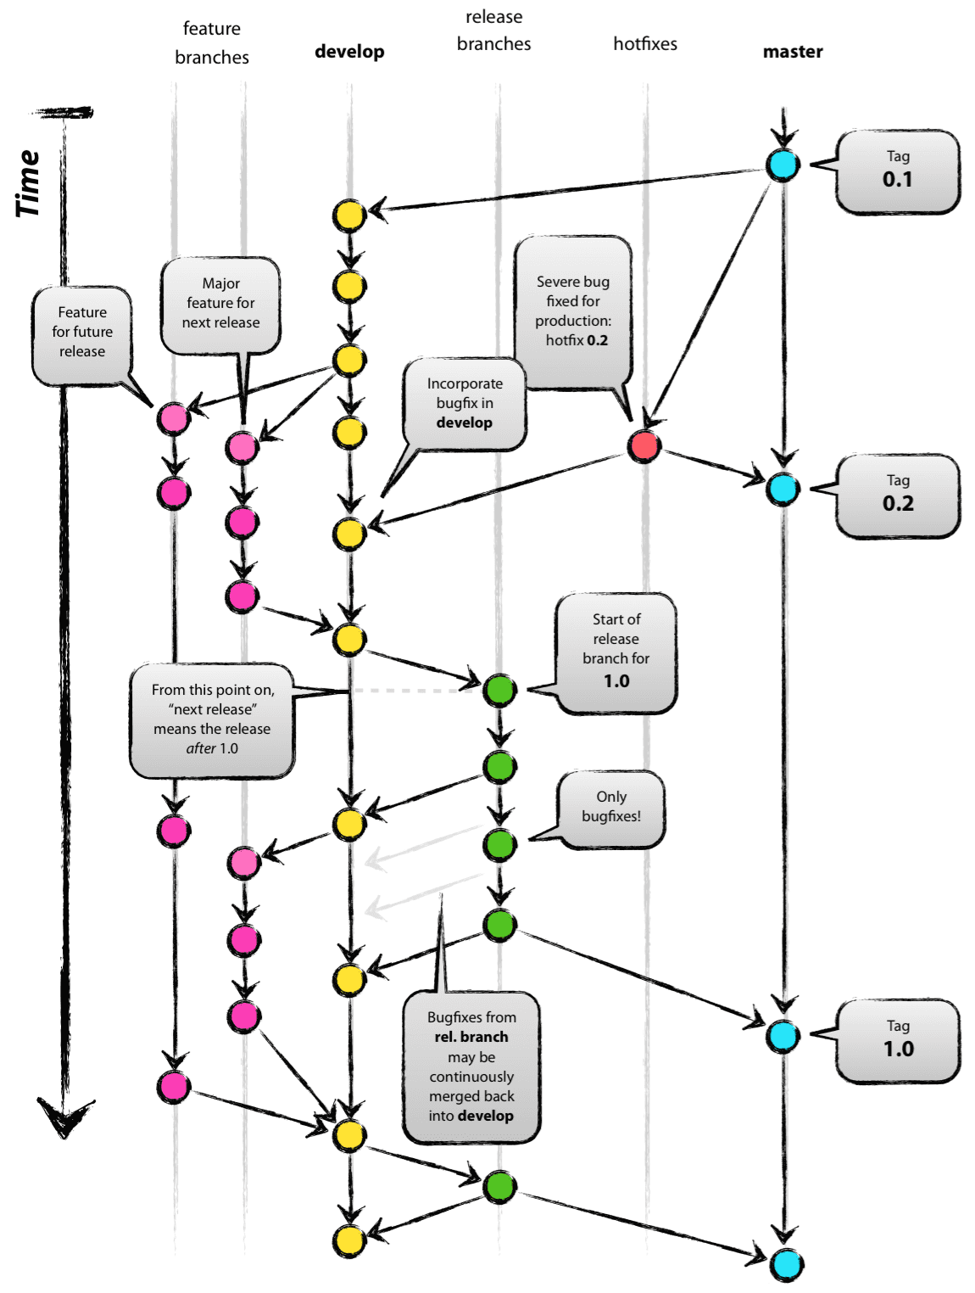

Slide 11
Branching Model
Branching model used depends on
Project Size
Team Size
Company
You can use any other variations of above branching model. But be consistent with it.

Slide 12
Final thoughts
Learning Git is a lot like programming
Integrating Git and collaborating effectively is a process
Rebasing, Issuing Pull Requests effectively
Fast-forward commits
Work on your GitHub profile

Slide 13
Good Reads
Successful Git branching model
http://nvie.com/posts/a-successful-git-branching-model/
Gist https://gist.github.com/jjpatel361/1d97bed699d6e1c419a1f6ed42195eb3
Will be available on DeepCS blog as well. (deepcs.wordpress.com)

Slide 14
Final Announcement
Feedback forms will be handed out to you. Please do let us know how this workshop went ☺
Want to conduct workshop come see us!
Have Ideas on next workshop ? Come meet any of E board members

Slide 15
Questions ?

